Slide 1
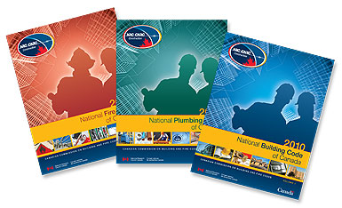
NBC Part 6 – HVAC
NPC – Plumbing
2010 NATIONAL MODEL CONSTRUCTION CODES
Cathleen Taraschuk, P. Eng.
NRC Canadian Codes Centre
February 2011
Notes:
Welcome
My name is ###########
The major topics of this presentation are the changes to the heating, ventilating and air-conditioning provisions in Part 6 of the National Building Code of Canada and the plumbing provisions in the National Plumbing Code of Canada.

Slide 2
Introduction
Presentation is part of a series on the 2010 National Model Construction Codes
Model codes developed by Canadian Commission on Building and Fire Codes
These codes must be adopted by provincial/territorial authorities to become law
Notes:
This Presentation is part of a series of 13
on the 2010 National Model Construction Codes.
It is important to note that the model codes, which are developed
by the Canadian Commission on Building and Fire Codes
must be adopted by provincial/territorial authorities to become law.
This may mean that code requirements enacted by legislation within your province or territory might differ from what is presented here.
Please check with your local authority.

Slide 3
HVAC Overview – NBC Part 6
Two substantive changes
  Acceptable air for ventilation
  Venting of laundry drying appliances
Notes:
There are two substantive changes to Part 6 of the NBC. The first introduces new requirements for acceptable air for building ventilation purposes. The second modifies existing requirements that address venting of laundry drying appliances, including collective venting of multiple installations.

Slide 4
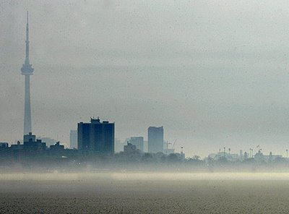
NBC Part 6 – Air for Ventilation
Assumption that air from outside is clean
Not true in all locations
  Possibly many Canadians exposed to poor air quality
New limits set for particulate matter, ground-level ozone and carbon monoxide
Notes:
There were no requirements in the 2005 NBC regarding what constitutes acceptable air for building ventilation purposes with respect to the concentration of particles and gases. The past practice of ventilating buildings assumed that the air being introduced to the indoor building environment was acceptable. It has become evident that, in some areas in Canada, the quality of the air being introduced may not be acceptable to ventilate buildings unless particles and gasses are first removed or reduced.
It has recently been estimated that many Canadians are exposed to poor air quality via the building ventilation system. Since using contaminated air to ventilate a building can create adverse health effects on the occupants, Part 6 of the 2010 NBC has set maximum levels of particulate matter, ground-level ozone and carbon monoxide in air for building ventilation purposes.

Slide 5
NBC Part 6 – Air for Ventilation
6.2.1.7. Outdoor Design Conditions
…
2) Except as provided in Sentence 6.2.2.4.(1), the outdoor air quality conditions of the geographic area of the building site to be used in designing ventilation systems shall conform to appropriate provincial or territorial requirements or, in the absence of such requirements, shall be equal to or less than the maximum acceptable levels stated in the National Ambient Air Quality Objectives of the Canadian Environmental Protection Act as follows:
…
Form part of the National Ambient Air Quality Objectives (NAAQOs), published under Section 8, Part 1, of the Canadian Environmental Protection Act (CEPA)
Notes:
These limits are based on the NAAQOs benchmark levels. The goal is to reduce the probability that, as a result of the design of the ventilation system, a person in the building will be exposed to an unacceptable risk of illness due to inadequate indoor air quality.
The National Ambient Air Quality Objectives (NAAQOs) identify benchmark levels of acceptable outdoor air quality for the protection of public health. These documents are published under Section 8, Part 1, of the Canadian Environmental Protection Act (CEPA). In order to manage the air quality of a building’s indoor environment, and thus reduce the occurrence of the occupants’ adverse health effects, the outdoor air for building ventilation purposes necessarily needs to be addressed.
The NAAQOs provide a legitimate source of information from cognizant authorities in determining the maximum acceptable levels of particles and gases that a building ventilation system should introduce directly to the interior environment. The air contaminants that have been identified, and objectives developed, are particulate matter, ground-level ozone and carbon monoxide.

Slide 6
NBC Part 6 – Air for Ventilation
When outside air is not "clean" enough as per 6.2.1.7.(2) with regard to particulate matter, ground-level ozone and carbon monoxide
6.2.2.4. Cleaning Devices
1) Where outdoor air quality conditions do not meet the requirements of Sentence 6.2.1.7.(2), ventilation required by Sentence 6.2.2.1.(1) shall be provided by a ventilation system designed to include devices that reduce particles and gases to the maximum acceptable levels described in Sentence 6.2.1.7.(2) prior to the introduction of outdoor air to indoor occupied spaces.
Notes:
A new requirement has also been added to address air for building ventilation purposes that is not within the limits set for particulate matter, ground-level ozone and carbon monoxide. The provision will make it a requirement to provide a means by which particles and gases are reduced to at least the set maximum levels prior to the introduction of outdoor air to the indoor occupied spaces.
This would reduce the potential that failure to remove these particles and gases at their point of origin would lead to an accumulation in excessive concentrations. The inclusion of this requirement would ensure that the indoor air quality is at an acceptable level, which in turn would reduce the occurrence of adverse health effects on the occupants.

Slide 7
NBC Part 6 – Venting of Laundry Drying Appliances
Discharge into building can lead to
  Poor air quality
  Fire hazard from lint build-up
  Excessive humidity
Health effects (eye irritation, respiratory illness… )
Mould and bacteria
Health
Deterioration of building components
Notes:
The discharge of contaminated and moisture-laden air into a building environment can create poor indoor air quality, a fire hazard and excessive humidity. This could cause adverse health effects on the occupants due to the particulates and other contaminants, and due to possible mould growth as a result.
For example, exposure to particulates at certain levels can cause various health effects such as eye irritation and respiratory illnesses as well as trigger asthma and allergy related symptoms. Also, excessive humidity, combined with the heat generated by the drying appliance, can accelerate a chemical reaction that triggers an increase in the off-gassing from materials and fabrics. Excessive humidity can encourage the growth of viable organisms such as mould and bacteria, cause a deterioration of the building assembly and cause the build-up of particulates such as lint which can be a fire hazard.

Slide 8
NBC Part 6 – Venting of Laundry Drying Appliances
6.2.3.8. Exhaust Ducts and Outlets
…
9) Exhaust ducts or vents connected to laundry-drying equipment shall discharge directly to the outdoors.
Controls contaminants and excessive humidity
Beneficial for health and reduces deterioration
of components
Notes:
To address these concerns, new requirements are added to Article 6.2.3.8. Exhaust Ducts and Outlets.
The new Sentence 9 provision controls the source of the contaminants by requiring that the venting of laundry drying appliances discharge directly to the outdoors. This would reduce the amount of particulates and the level of humidity in the indoor building environment, therefore increasing the indoor air quality of the building. Control of the source of the contaminants would also reduce the occurrence of fire and the deterioration of the building assembly.

Slide 9
NBC Part 6 – Venting of Laundry
Drying Appliances
6.2.3.8. Exhaust Ducts and Outlets
…
8) Where collective venting of multiple installations of laundry-drying equipment is used, the ventilation system shall
a) be connected to a common exhaust duct that is vented by one central exhaust fan and incorporates one central lint trap,
b) include an interlock to activate the central exhaust fan when laundry-drying equipment is in use, and
c) be provided with make-up air.
Notes:
Sentence 8 addresses the collective venting of multiple installations of laundry drying appliances, which can cause a build-up of lint in the exhaust ducts when one or more laundry drying appliances are not in use. Collective venting may also cause short-circuiting of the air to non-operating drying appliances. These situations may cause a fire hazard.

Slide 10
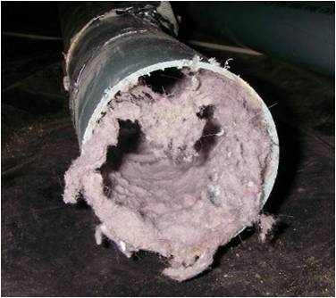
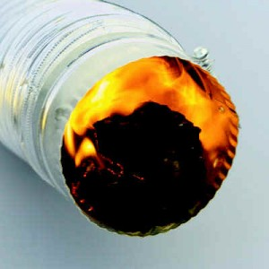
NBC Part 6 – Venting of Laundry Drying Appliances
Collective venting → lint build-up and/or short circuiting
of air → fire hazard
Provision requires
  Common exhaust duct and fan to prevent short circuiting of air
  Central lint trap for easy access and cleaning
Notes:
This new provision will require a common exhaust duct with a central exhaust fan and a central lint trap in order to create a continuous negative pressure in the plenum, which prevents back drafting or short-circuiting of the air to non-operating drying appliances. This would reduce the risk of fire associated with the build-up of lint.
Although requirements for access to appliances are already generally specified in Part 6, explanatory information is included to remind the users of the code that the venting of clothes dryers forms part of the ventilation systems and therefore access to central lint traps should also be readily accessible for servicing.

Slide 11
NPC – Plumbing Overview
Water pipe sizing
Non-potable water system design
Composite polyethylene/aluminum/polyethylene piping use for hot water
Miscellaneous
  Traps for floor-mounted sinks
  Suds pressure zones
  Standpipe and trap dimensions
  Drainage of roofs
Notes:
Next, the changes to the National Plumbing Code of Canada will be reviewed, and include water pipe sizing, non-potable water system design, composite piping, and other miscellaneous items.

Slide 12
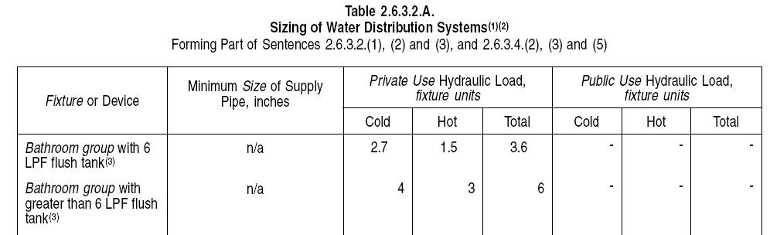
NPC – Water Pipe Sizing
New materials, appliances, equipment → need to update and expand material on sizing of water distribution systems
Deletion of "Minimum Flow Pressure" values – conflict
with standards
Notes:
Work was undertaken to review new materials and technologies to determine if changes were needed to the pipe sizing information in the NPC. It was concluded that the information needed to be updated since the use of water-conserving appliances and fixtures in buildings and facilities is becoming standard practice. This results in a lower water usage, which has an impact on the water pipes delivering water to the building or facility.
Material was developed resulting in a number of changes to Section 2.6, which in turn created some discrepancies in the NPC. Therefore, a multitude of minor changes were made to address these discrepancies as well as for clarification and updating purposes. For examples, outdated values have been revised and, new materials and fixtures introduced, in order to reflect modern plumbing systems.
In Table 2.6.3.2.A., because of a conflict with referenced standards, the minimum flow pressure values given in the 2005 table were deleted.

Slide 13
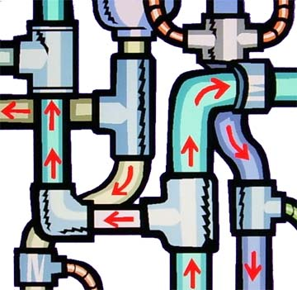
NPC – Water Pipe Sizing
Update to
Article 2.6.3.4. Sentences and Table 2.6.3.4.A.
Notes:
Additional information has been added to clarify the method of designing hot and cold water systems for residential buildings by providing a generic method of design for water velocity.

Slide 14
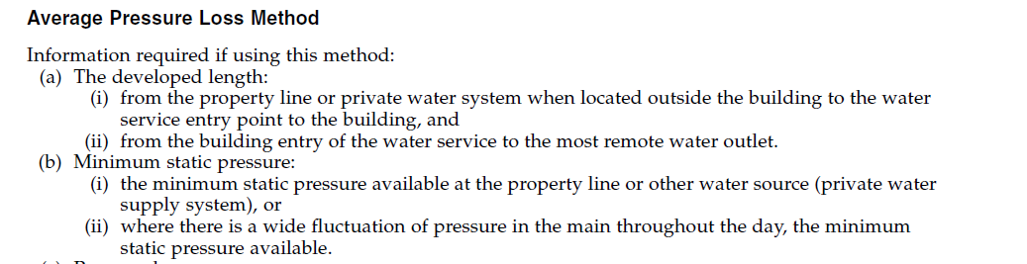
NPC – Water Pipe Sizing
Explicit appendix information on hydraulic load
Additional information and examples of design calculations for small commercial buildings by:
  Empirical method
  Pressure loss method
Notes:
Appendix information regarding hydraulic load was updated and expanded upon to provide additional explanation as well as offer examples of water piping system design calculations for small commercial buildings using an empirical method. It also describes an average pressure loss method.

Slide 15
NPC – Water Pipe Sizing
Quality of water (hardness, pH, …) effect on pipe material
Addressed in Appendix Note
Notes:
Other appendix material was developed to provide guidance to the designer of water distribution systems as to what should be considered to ensure acceptable water quality destined for use as potable water.

Slide 16
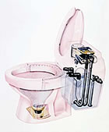
NPC – Water Pipe Sizing
New provisions – sizing systems using direct flush valves
Updated appendix material – water system sizing
for 1 and 2 unit dwelling units or row houses
Notes:
Requirements are provided for sizing systems that use direct flush valves such as urinals and water closets.
Appendix material was updated to provide a simplified method of water system sizing that is permitted in buildings containing one or two dwelling units or row houses with separate water services.

Slide 17
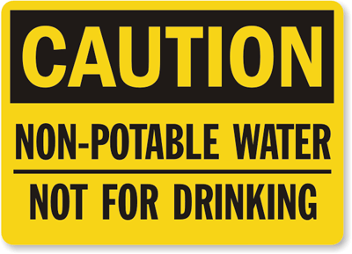
NPC – Non-Potable Water System
May be installed only
  To supply water closets, urinals, and
  Directly connected underground irrigation systems
  that only dispense water below surface of ground
Designed to ASHRAE Handbooks, ASPE Handbooks and CAN/CSA-B128.1 "Design and Installation
of Non-potable Water Systems"
Notes:
A new provision was developed to address non-potable water system design in recognition that these types of systems are presently being installed. It addresses non-potable water used to supply water closets, urinals, and directly connected underground irrigation systems that only dispense water below the surface of the ground. The design, fabrication and installation of a non-potable water system must be in accordance with good engineering practice.
The referenced documents only apply to the extent that they relate to the objectives of the NPC. In this case, the objective is health. Therefore the NPC doesn’t explicitly mandate the installation of non-potable water systems; it just says that if you install such a system, that you would need to “design, fabricate and install” it in such a way that it limits the probability that it could lead to harms to persons.

Slide 18
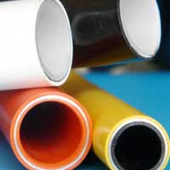
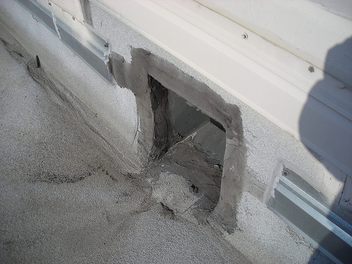
NPC – Other
PE/AL/PE pipe rated ≥ 690 kPa at 82°C can
be used for hot water systems (interim change)
Exemption to cleanout requirement
for floor mounted service sink
Roof with parapet heights > 150 mm
  Emergency scuppers, and
  2 or more roof drains
Increased diameter of pipe and trap for
clothes washer – due to changes in design
Notes:
An interim change was sought and secured to ensure that an improved composite piping product made of polyethylene/aluminum/polyethylene, which is suitable for hot water applications, was recognized by the NPC. It was demonstrated that the application of Sentence 2.2.5.13.(2) that prohibited this product was no longer justifiable.
Since mop or service sinks are typically floor mounted and are not usually provided with an accessible trap, the relevant provision was modified to provide an exception for these types of sinks.
The capacity and spacing of scuppers is clarified to prevent the pooling of water on the roof which could result in structural damage to the building envelope. On roofs with a single roof drain, and where the parapet height exceeds 150 mm or the adjacent wall flashing height, rainwater could enter the building and cause damage should the roof drain become plugged or overwhelmed by a rainfall exceeding the 15-minute rainfall. A new provision has been added to provide a safeguard to this by requiring emergency roof overflows or scuppers and a minimum of 2 roof drains.
Due to changes in clothes washer designs, and the prevalence of front-loading machines with faster pump capacities, standpipe and trap dimensions have been changed to prevent overflowing.

Slide 19
NPC – Other
High sudsing detergents → disrupt venting systems
Notes:
High-sudsing detergents used in clothes washers produce suds that tend to disrupt the venting action of venting systems. This can result in spreading of the suds through the lower portions of multi-storey drainage systems and backup of the suds into fixtures. Revisions were made to the NPC to provide guidance on how to avoid the creation of suds pressure zones.

Slide 20
www.nationalcodes.ca
Questions?
Send them to us at codes@nrc-cnrc.gc.ca
Thank you!
Notes:
Thank you, if you have any questions, please e-mail them to …

